Slide 1
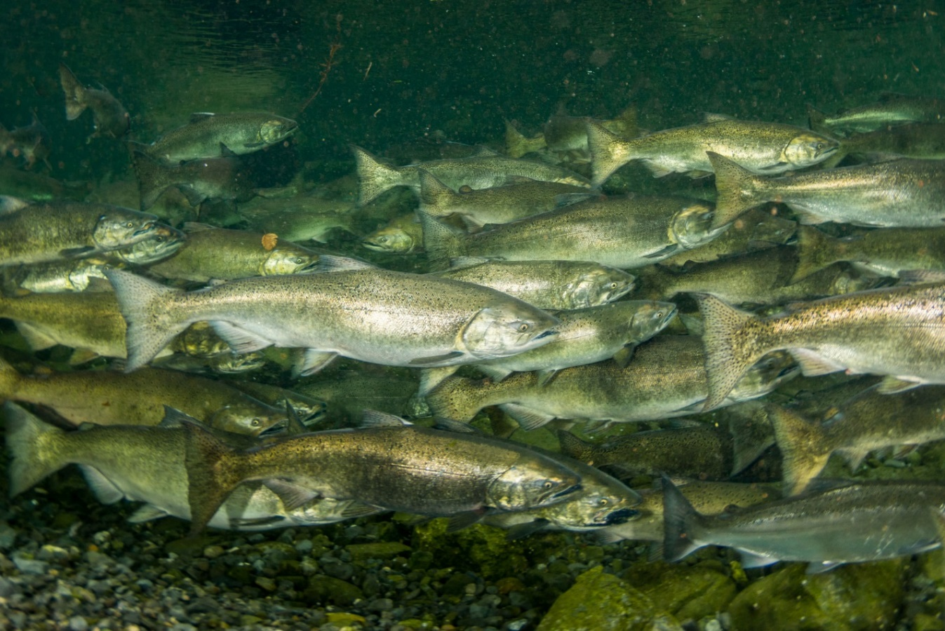
ROGUE RIVER HATCHERY MITIGATION
County Commissioners Meeting
31 October 2019

Slide 2
PURPOSE
Define current and future hatchery mitigation mission in Rogue River Basin
(Help answer the “management objectives” question raised by Commissioners)
OUTLINE
Authority for program
Program evolution
Current contract and program description

Slide 3
AUTHORITY FOR PROGRAM
The Project (Lost Creek, Elk Creek, & Applegate) was authorized in the Flood Control Act of 1962 substantially in accordance with the recommendations of the Chief of Engineers contained in accompanying House Document 87-566
Authorization included, among other things, fish facilities (including a hatchery) to mitigate for the loss of fish spawning habitat, but did not identify a specific number of fish to be produced at the hatchery
Fish facility size and initial mitigation was based, in part, on the “Detailed Report on Fish and Wildlife Resources, Rogue River Basin, Oregon-California” USFWS, December 1961
1,500 spring Chinook “passed above the Lost Creek damsite…” (Location A-3)
Based on survey data from 1949 to 1954
Exact location of construction uncertain – changes estimates
Limited use of boats and fixed-wing aircraft
Notes:
This report also identified and enumerated other species impacted: coho, steelhead

Slide 4
AUTHORITY FOR PROGRAM
Refinement #1 “Rogue River Spring Chinook Salmon Spawning Ground Survey, Upper Rogue River, 1964”, Oregon State Game Commission
31% of spring Chinook passing Gold Ray Dam spawned in mainstem Rogue River above B-1 powerhouse location
Percentage was applied to Gold Ray Dam counts in 1964 showed 9,900 spring Chinook adults blocked from accessing spawning areas above the dam site
Gold Ray Dam counts demonstrated 16% jacks, thus fisheries agencies reduced figure to “8,300 adults”
Multi-agency spawning ground survey, but surveyed only one year
Intense use of ground, boat and helicopter examinations of spawning grounds

Slide 5
AUTHORITY FOR PROGRAM
Refinement #2 December 1966 letter from Oregon State Game Commission and Fish Commission
1965 record return year for spring Chinook: 49,420 at Gold Ray Dam
1965 surveys corroborated 31% figure, but adjusted for planned “fish velocity barrier” downstream of B-1 site
1965 Calculation
Gold Ray Dam Count (1965): 49,420
Subtract sport catch above Gold Ray Dam: -5,000
Subtract Big Butte Creek Run: -1,900
Assumed 7.5% PSM applied to remainder and subtracted: -3,190
Proportion above velocity barrier (33.1%)
Adults to mitigate for: 13,020 (includes jacks)

Slide 6
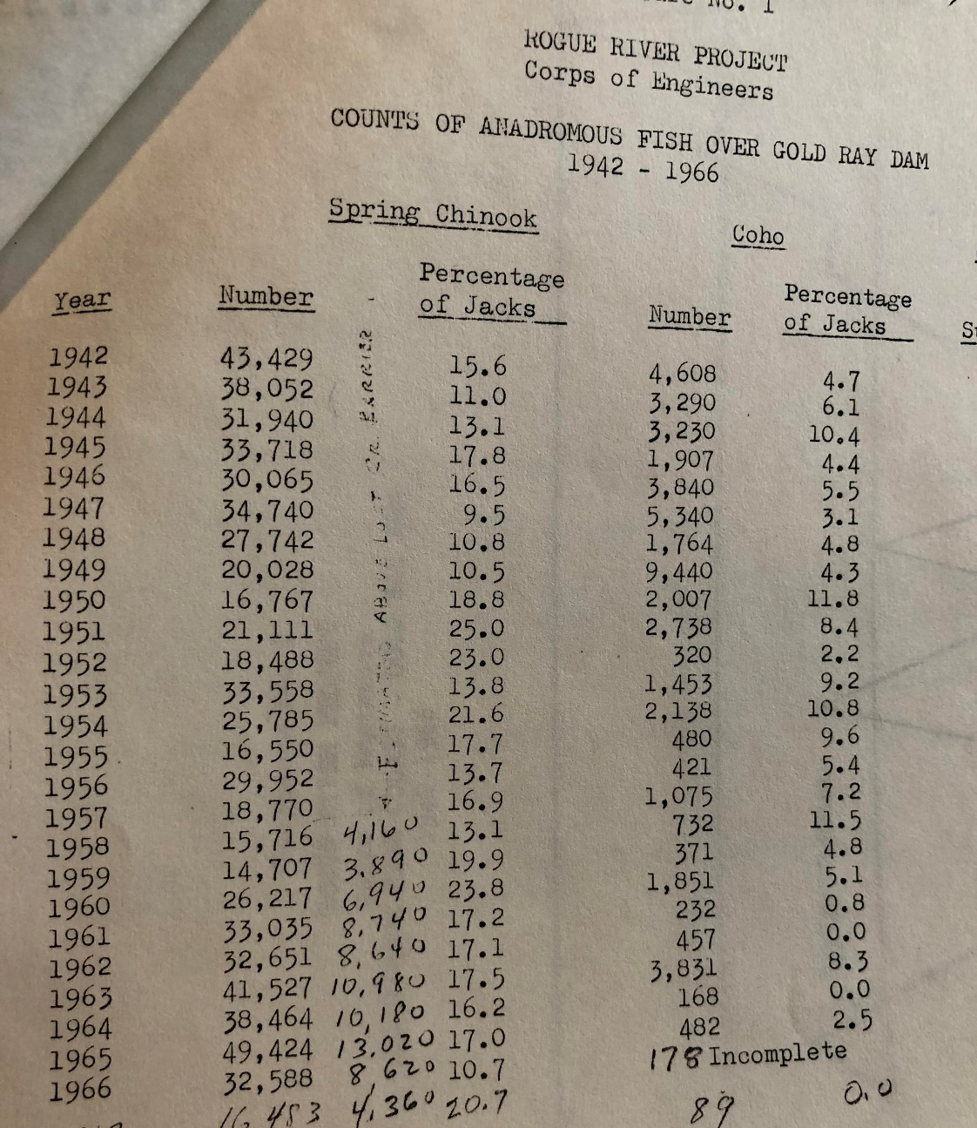
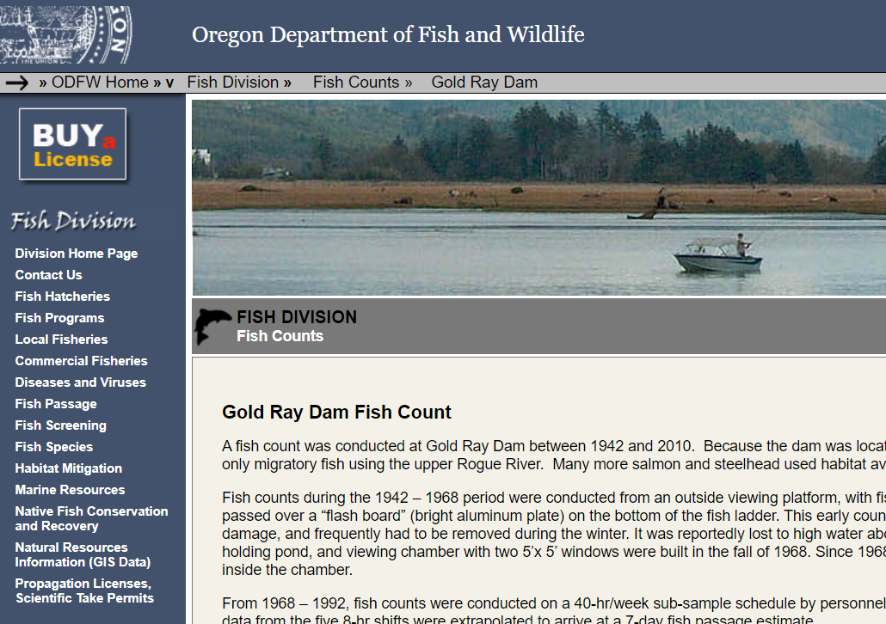
AUTHORITY FOR PROGRAM

Slide 7
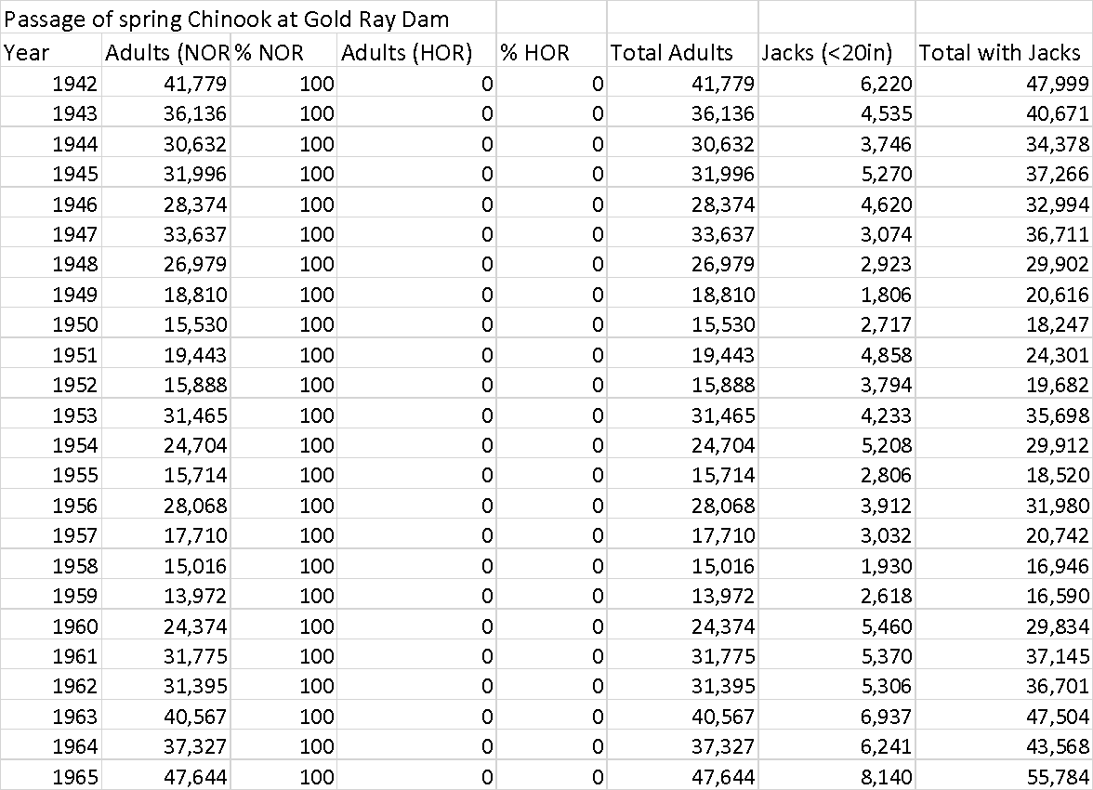

Slide 8
Average Total Return (NORs + Jacks) 1942 to 1971: 33,219
Using 1965 Calculation: |  | 33,219
Less sport catch 5,000 |  | 28,219
Less Big Butte Creek run 1,900 |  | 26,319
Less 7.5% PSM |  | 24,345
% spawning above barrier (33.1%) |  | 8,058

Slide 9
AUTHORITY FOR PROGRAM
13,020 figure is included in Design Memorandum No. 8 “Fish Facilities” USACE, 1967
Within DM No. 8, 13,020 figure presented as recommendation by fish management agencies, so hatchery was sized to support this number
Not presented as a promise, guarantee, or assurance of adult returns

Slide 10
PROGRAM EVOLUTION
Corps of Engineers and Fish Commission of Oregon signed formal “agreement” in Feb 1966 for Fish Commission to produce fish on behalf of the Corps
2.5M spring Chinook juveniles at 15 fpp (166,667 pounds) → Based on 8,300 adults (‘64 data)
US Government and Oregon State Game Commission signed contract in Aug 1972 for Game Commission to produce fish on behalf of the Corps
263,000 pounds at release for spring Chinook → Based on 13,020 adults (‘65 data)
Production agreement/contract identified the number of fish the State would produce on behalf of the Corps but included clause that numbers could be “changed by mutual agreement of those concerned”
Elk Creek Dam uncertainties regarding mitigation also lead to fish production flexibility (numbers and species proportions) as long as total poundage not exceeded

Slide 11
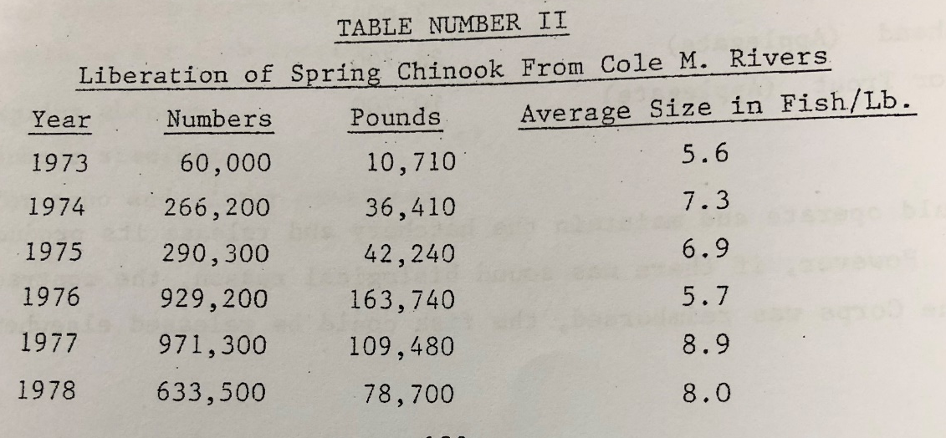
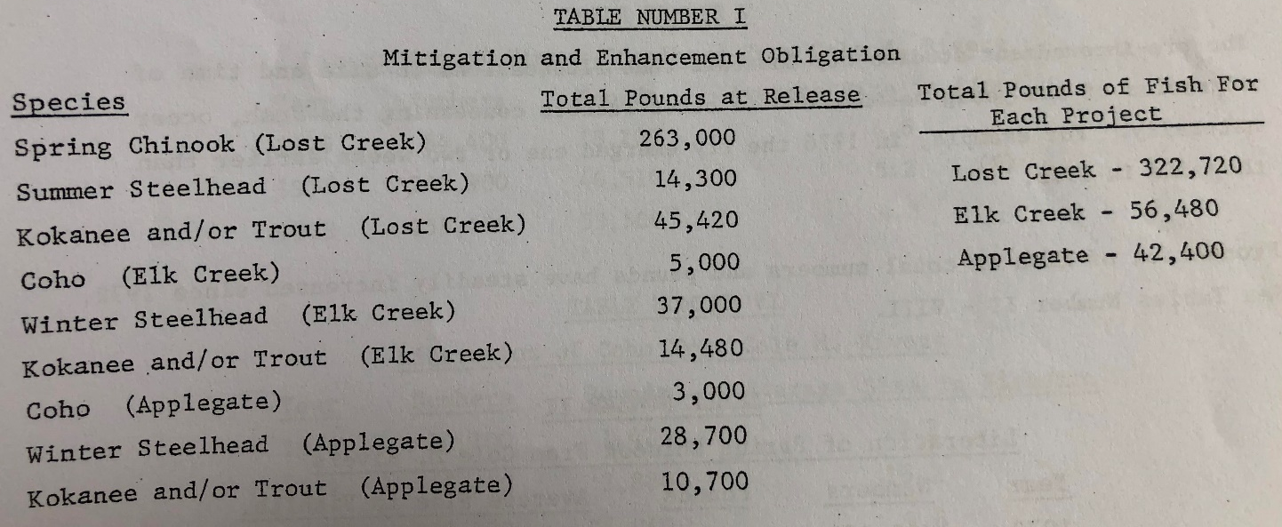
PROGRAM EVOLUTION
Spring Chinook production numbers have fluctuated over time
However, “up to 263,000 pounds” for ChS remained constant in 1972 contract, 1990 cooperative agreement, 2012 cooperative agreement with State for production, with “flexibility” clause
Changed to 178,600 pounds in 2017 production contract with State
1,825,100 total juvenile release with 1,703,250 smolts
Coordinated adjustment to ChS production with ODFW and NMFS
Consistent with 2016 Spring Chinook HGMP (Rogue Stock 52) and 2007 Conservation Plan

Slide 12
PROGRAM EVOLUTION
Hatchery mitigation historically expressed as pounds
Cole Rivers Hatchery produces mitigation for Lost Creek and Applegate (collectively, the Project)
USACE mitigation goal for the Project is 365,120 pounds in total

Slide 13
PROGRAM EVOLUTION
1990 Cooperative Agreement:
“This poundage schedule will be sufficient to maintain the hatchery equivalent of the production, including harvest, from the 13,020 wild spring chinook spawners and 500 wild summer steelhead spawners which returned to the area above Lost Creek Dam and the 500 wild coho spawners and 2,000 wild winter steelhead spawners which returned to the area above Applegate Dam. The Corps recognizes the States need for fish management flexibility for the Rogue Basin, therefore, the above schedule serves only as an agreement guideline for the various species to be reared. The Corps expects the annual production for each species to fluctuate, however, the total (365,120 pounds) should not be exceeded on a regular basis with corps funding.”
USACE remains committed to meeting mitigation goal
USACE relies on fish agency co-managers to propose appropriate proportion, number, size of each stock
USACE ensures proposed production fits its mitigation need and purpose

Slide 14
CURRENT CONTRACT AND PROGRAM DESCRIPTION
Current contract signed in 2017 with option years extending to 31 August 2020
Contract language: “The Contractor will produce a maximum quantity of 1,825,100 (178,623 pounds) spring Chinook salmon and release fish into the Rogue River, as well as a portion into standing water bodies in accordance with the target release schedule”
Qty. | Fpp | Pounds | Release Month
20,000 | 950 | 21 | Feb
150,000 | 64 | 2,344 | Jun
50,000 | 64 | 781 | Jun
578,877 | 13 | 44,529 | Aug
630,000 | 9 | 70,000 | Sep
300,000 | 6.5 | 46,154 | Oct
5,100 | 6.5 | 785 | Oct
91,000 | 6.5 | 14,000 | Mar
Total Releases | Ave fpp | Total Pounds
1,825,100 | 10.8 | 178,623

Slide 15
BACKUP SLIDES

Slide 16
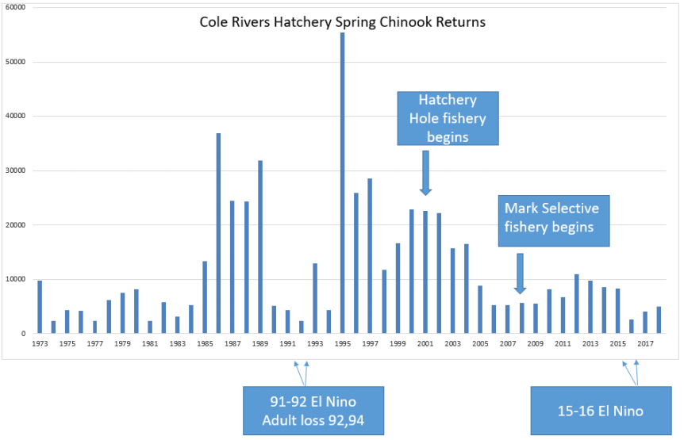

Slide 17
WHAT IS AN EIS?
An environmental impact statement (EIS) is a government document that outlines the impact of a proposed project on its surrounding environment
An EIS is mandated by the National Environmental Policy Act of 1969 (NEPA), to assess the potential impact of actions “significantly affecting the quality of the human environment ” This requirement under NEPA does not prohibit harm to the environment, but rather requires advanced identification and disclosure of harm
An EIS outlines the status of the environment in the affected area, provides a baseline for understanding the potential consequences of the proposed project, identifies positive and negative effects for the environment, and offers alternative actions, including inaction
One of three possible environmental review categories under NEPA: categorical exclusion determination, environmental assessment, and an environmental impact statement
EISs are tools for informing the public about the development and engineering of the built environment, as well as windows into the civic planning that shapes communities. They reveal details about the environmental health and development of a specific area in a comprehensive report.

Slide 18
